Slide 1
COMP1003 – Algorithms, Data Structures and Maths Lecture 14 From Diagrams to Code
Thomas Wennekers
University of Plymouth

Slide 2
Main Ideas
Graphical tools can help to visualise the structure of code
Flow diagrams and structograms visualise control flow
Notes:
qqq

Slide 3
Why is this important ?
Well designed code is easier to maintain and communicate, either between members of a coding team or to customers.
Good planning reduces “trial-and-error” coding in favour of a more systematic approach.
Visualisation helps beginners to get started.

Slide 4
Aims and Objectives
To understand the usefulness of diagrammatic code development.
To realise the importance of structured programming and modular code.

Slide 5
Outline
Flow Diagrams
Structograms / Nassi Shneiderman Diagrams

Slide 6
Flow Diagrams

Slide 7
Control Flow
CPUs are (ideally) sequential machines; at each moment they perform one operation only
Statements organise the “flow of control”, i.e. which operations are performed in what order
There are few major control elements only:
statements and sequences thereof
conditional branching (if-then, if-else, switch)
repetition (for-loop, while-loop, repeat-until)
jumps (goto, break, continue)

Slide 8
Flow Diagrams
Flow diagrams were an early tool to visually represent the flow of control in programs
They may still be used at a beginning stage of learning to code
However, they are outdated for a number of reasons (later more about this)

Slide 9
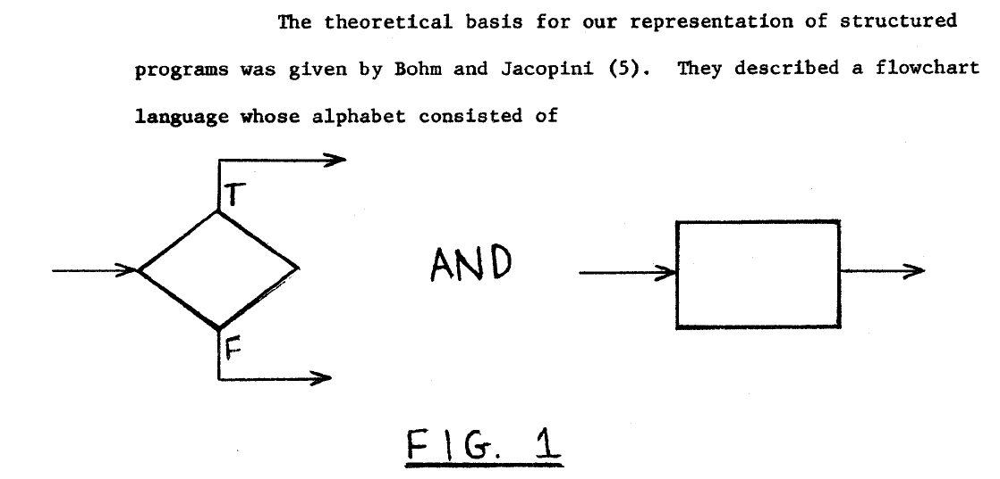
Flow Diagrams

Slide 10
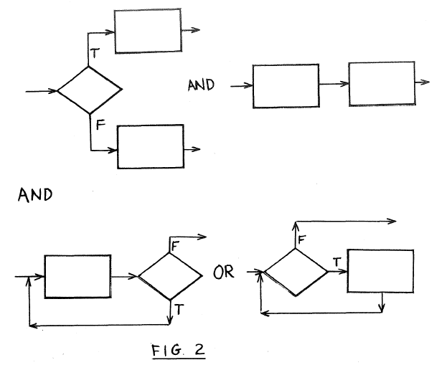
Flow Diagrams
if-then-else statement-sequence
do-while while-do or for-loop

Slide 11
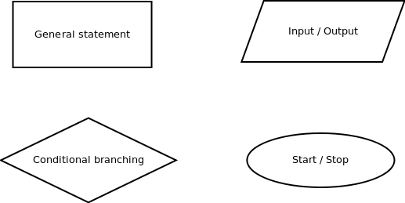
Basic Elements of Flow Diagrams
… plus directed edges to link the boxes ...

Slide 12
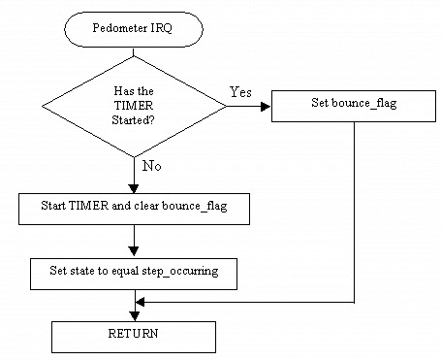
Example 1: A Flow Diagram

Slide 13
Example 2: Construct a Flow Diagram
Task: Ask the user for a number; sum all integers up to that number and print the result

Slide 14
Example 2: Pseudo Code
program sumN
read N from user
sum = 0
for i =1 step 1 to N
sum = sum + i
print sum

Slide 15
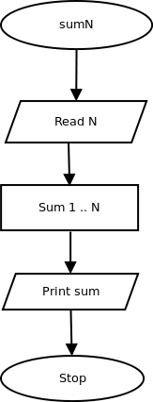
Example 2: Coarse Diagram
This diagram precisely reflects the task
but
What is “Sum 1...N” ?

Slide 16
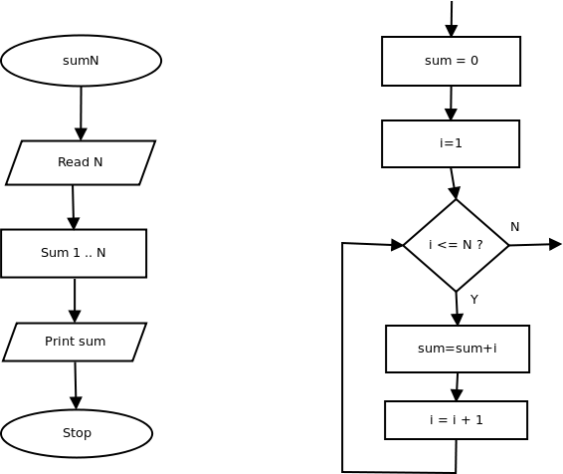
Example 2: Refined Diagram

Slide 17
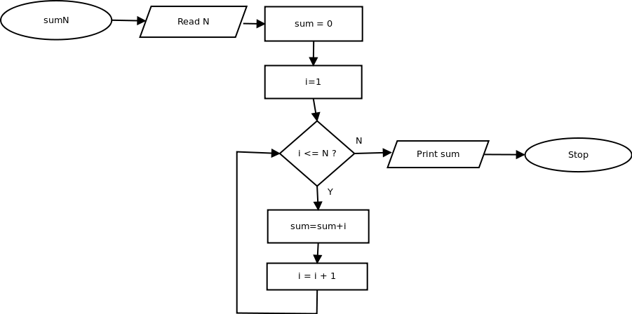
Example 2: Combined Diagram
Simple task, but already a complex diagram ...

Slide 18
Drawbacks of Flow Diagrams
They are only usable for small size programs
They do not well support for- and while-loops, or recursion
They do lead to an uncontrolled use of “goto”
This results in hard to read and maintain
“Spaghetti code”

Slide 19
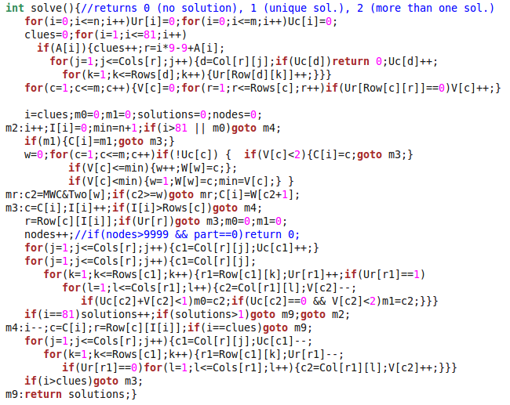
Spaghetti Code (a Sudoku solver)

Slide 20
Structograms
(Nassi-Shneiderman Diagrams)

Slide 21
Structured Programming
Break problems into pieces according to the problem structure
Break pieces into smaller pieces, etc.
Don't refer to specific language elements early
Pieces interact via “interfaces” but are otherwise independent
Project – modules – functions – fragments

Slide 22

Structogram : Process
Can contain a single statement or a bigger functional block depending on the resolution
Flow enters on top and exits on bottom of the element

Slide 23
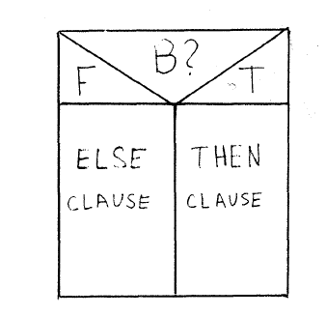
Structogram : Decision
If condition B is true do the THEN-clause else do the ELSE-clause; Note: the clauses are process blocks

Slide 24

Structogram : for- & while-loop
A process block embedded in a loop, where the loop's exit condition is evaluated at the beginning

Slide 25

Structogram : do-while-loop
A loop where the exit condition is checked at the end (do-while-loop or repeat-until-loop)

Slide 26
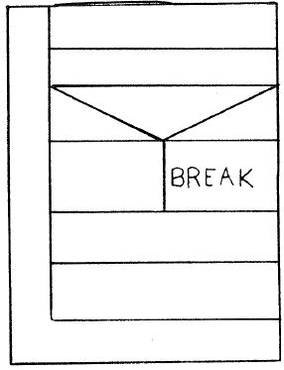
Structogram : Break/Continue
Similar for for- and while-loops

Slide 27
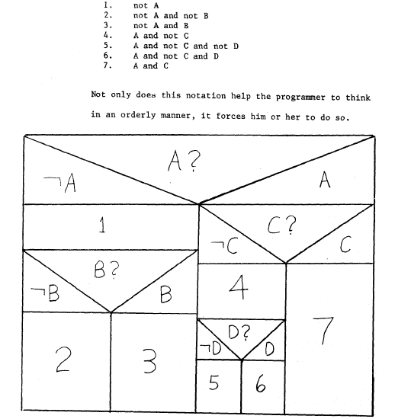
Structogram : Logic Example

Slide 28
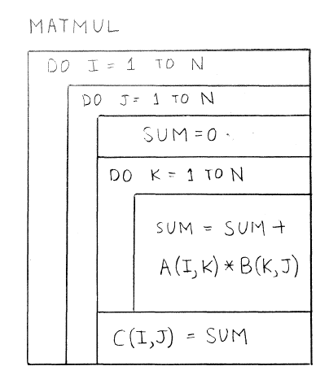
Structogram : Nested Loops
Observe blocks in blocks
and three nested loops
Matrix Multiplication

Slide 29
Structogram : Example “Sum”
Task: Ask the user for a number; sum all integers up to that number and print the result

Slide 30
Structogram : Example “Sum” Pseudocode
solution using a for-loop
read N
sum = 0
for (i=1; i<=N; i++)
sum = sum + i
print sum

Slide 31
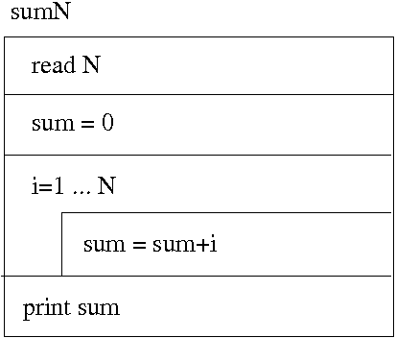
Structogram : Example “Sum”
The structogram text can often be used to comment the final code

Slide 32
Structogram : Example “Primes”
Task: Read a number N from the user and print all prime numbers up to N (inclusive)
Note: A prime number is an integer that can only be divided by 1 and itself. One (1) is not considered to be prime.

Slide 33
Example : Primes
Informal solution:
1) Assume we can determine if a number is a prime. We can then just go through all numbers from 2 to N and if they are prime print them.

Slide 34
Primes : Pseudo Code
primes
read N;
for (p=2; p<=N; p++)
if (isPrime(p))
print p;

Slide 35
Example : Primes
Informal solution:
1) Assume we can determine if a number is a prime. We can then just go through all numbers from 2 to N and if they are prime print them.
2) How to decide a number p is prime? Just try to divide it by all numbers from 2 to p-1. If it is dividable without remainder by any, it can't be prime.

Slide 36
isPrime : Pseudo Code
isPrime( p )
for (d=2; d<p; d++)
if (p%d == 0)
return false;
return true;

Slide 37
Primes : Pseudo Code
isPrime( p )
for (d=2; d<p; d++)
if (p%d == 0)
return false;
return true;
primes
read N;
for (p=2; p<=N; p++)
if (isPrime(p))
print p;

Slide 38
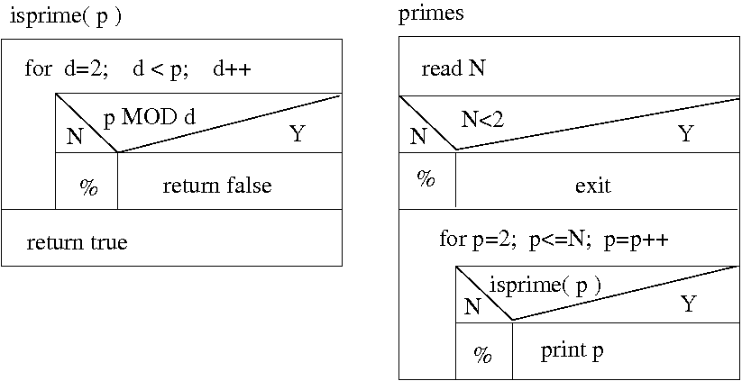
Example : Primes Structograms

Slide 39
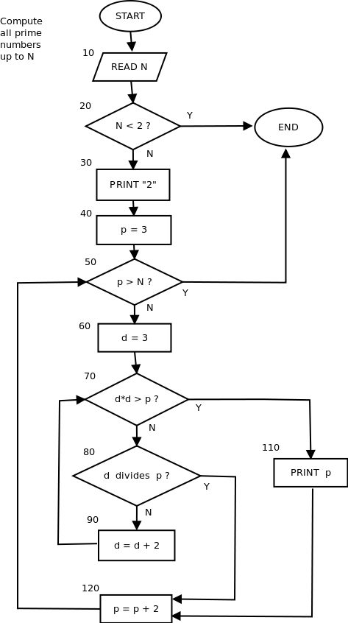
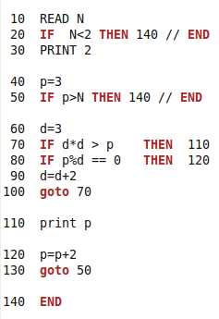
Primes : Flow Diagram and Spaghetti Code (BAD!)

Slide 40
Outcomes
An idea of structograms (Nassi/Shneiderman diagrams) as a first step to develop structured code.
Flow-diagrams as an alternative to structograms that, however, does not support structured programming

